Slide 1
Catan Map Generator Online Tool for Balanced Gameplay
Made by: Neumann Máté Soma (VRRPKR)

Slide 2
Topic Description (1)
About the game
A strategic board game designed by Klaus Teuber, first published in 1995. It is played by 3-4 players (expandable to 5-6 with extensions) on a fictional island, Catan, where players act as settlers collecting resources, trading, and building settlements, roads, and cities.
Core issues
The game board consists of hexagonal tiles, each representing a resource (brick, desert, ore, sheep, wheat, wood) with a number from 2 to 12. Unbalanced maps (e.g., identical resources or numbers adjacent) can create unfair advantages or disadvantages, reducing game enjoyment.
Existing Catan map generators (e.g., the reference website) often have outdated, non-user-friendly designs, diminishing the user experience. Their non-responsive interfaces fail to meet modern browser and device expectations, making them unattractive and unintuitive.

Slide 3
Topic Description (2)
Solution
Create a web-based Catan Map Generator that runs in a browser, producing balanced, customizable maps. Players can set rules to adjust map generation.
The design was revamped for a more user-friendly and visually appealing interface. Using Bootstrap, the website was made responsive, ensuring clear and aesthetic display across various device sizes.
Rules
6 & 8 can touch
2 & 12 can touch
Same numbers can touch
Same resources can touch
Randomize ports
Varied resource numbers
The first 4 rules were given, those are needed for a balanced map, but the last two were introduced to enhance distribution diversity and gameplay fairness.

Slide 4
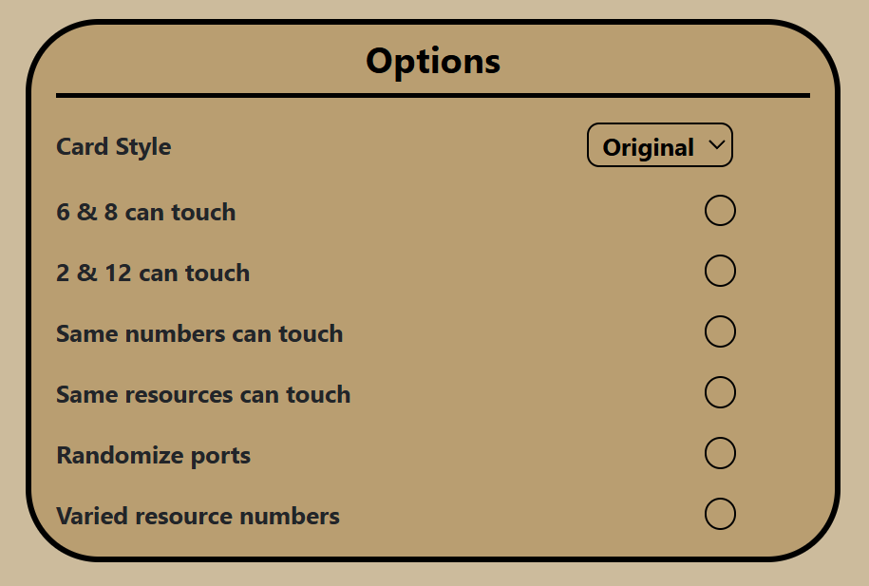
Technical Description (1)
Rule Descriptions
6 & 8 can touch: Allows tiles with 6 and 8 to be placed next to each other.
2 & 12 can touch: Permits tiles with 2 and 12 to be placed next to each other.
Same numbers can touch: Enables tiles with identical numbers to be adjacent.
Same resources can touch: Allows tiles with identical resources to be adjacent.
Randomize ports: Ports are randomly placed on sea tiles around the map.
Varied resource numbers: When enabled, identical resources cannot have the same number.

Slide 5
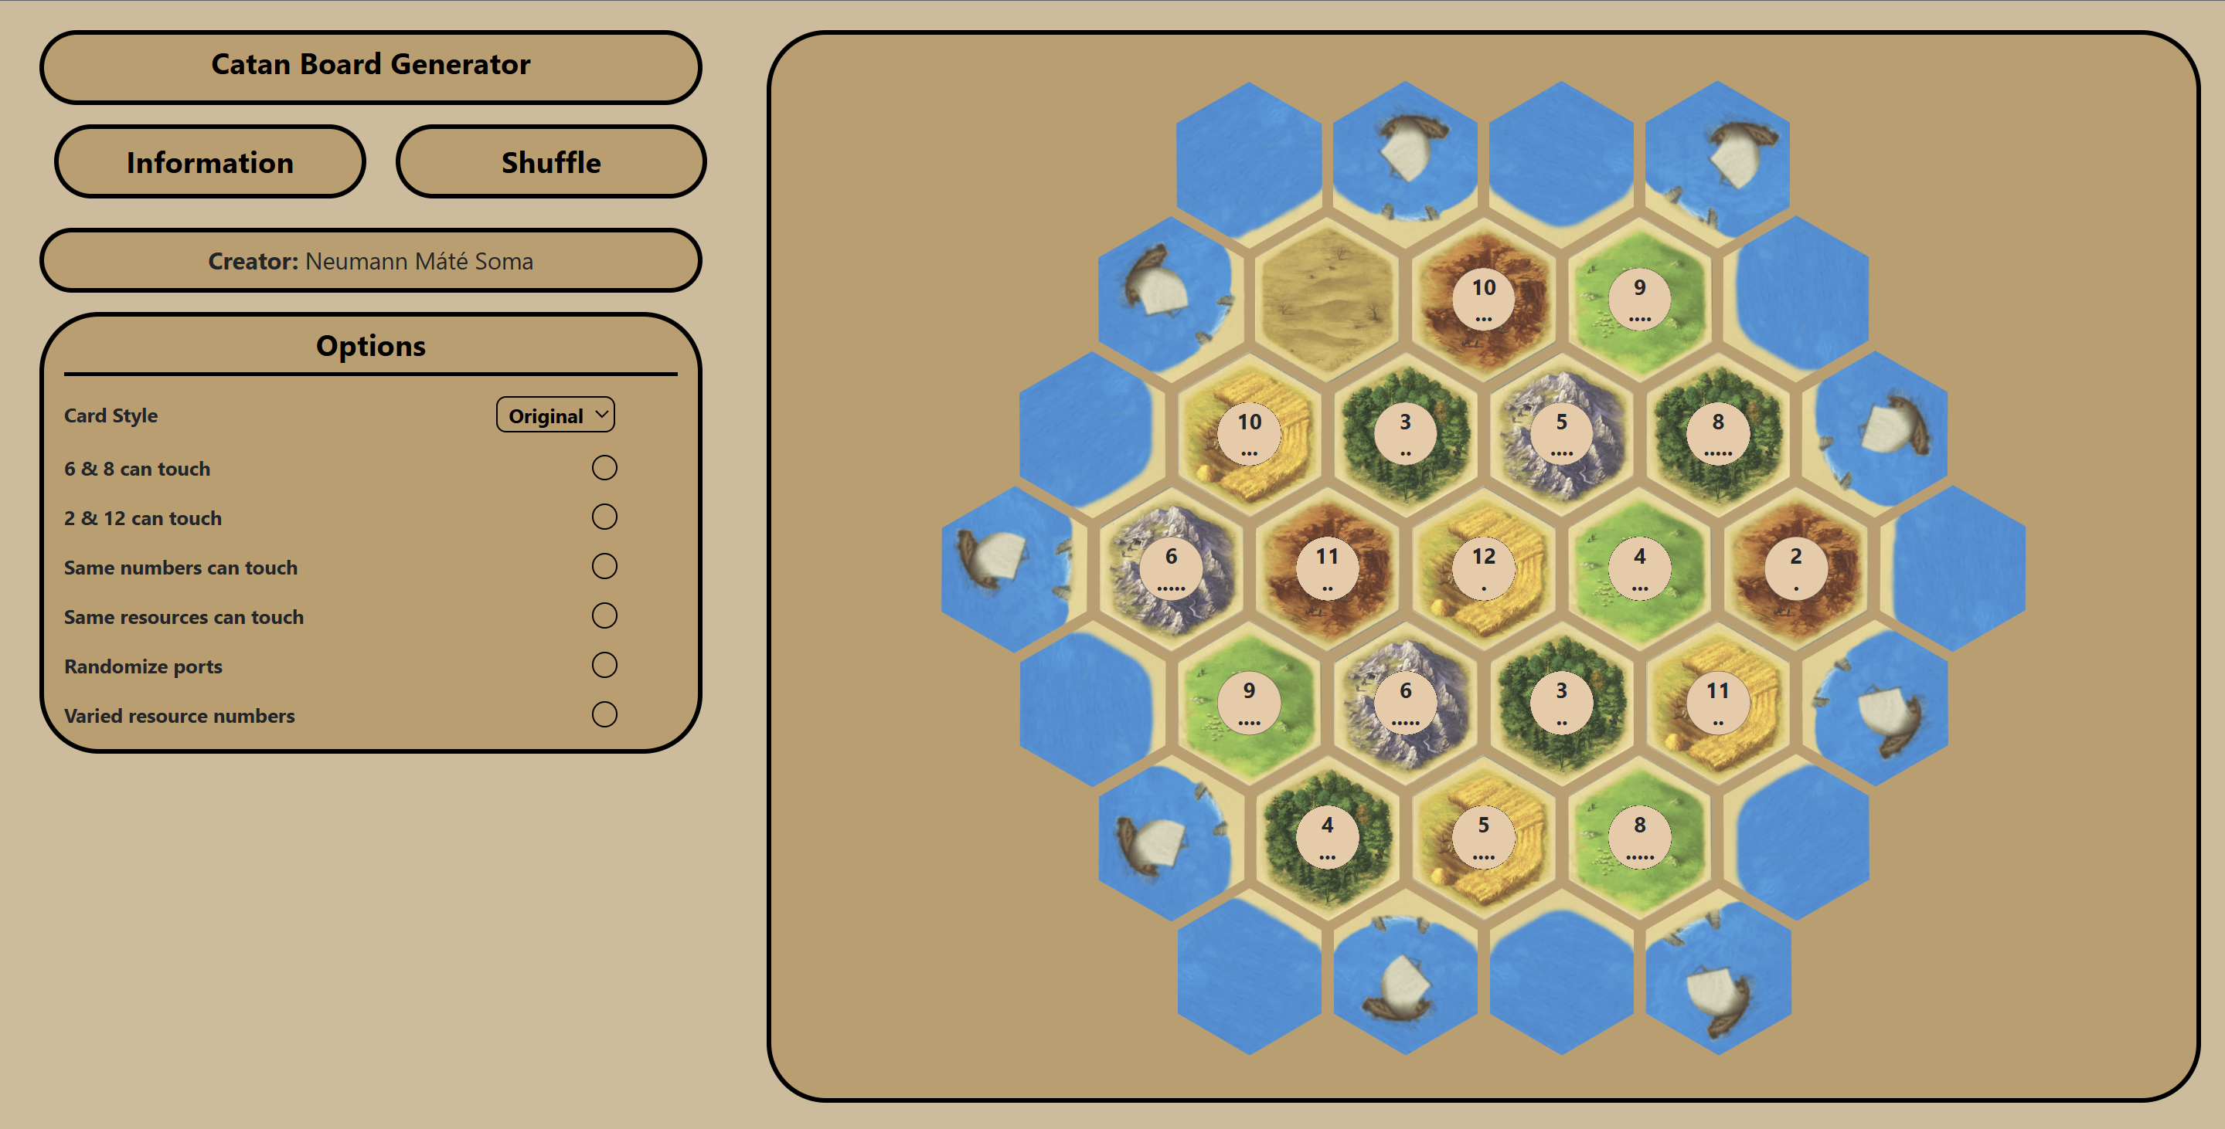
Technical Description (2)
Redesigned UI
The biggest challenge was redesigning the UI into a more updated and suitable one. I wanted to create something which gives a good user experience and is visually appealing, with a semi minimalist look.

Slide 6

UI Description (1)
Website overview
The website features a responsive, user-friendly interface for generating balanced Catan maps, with a header, options bar, and interactive map grid.

Slide 7
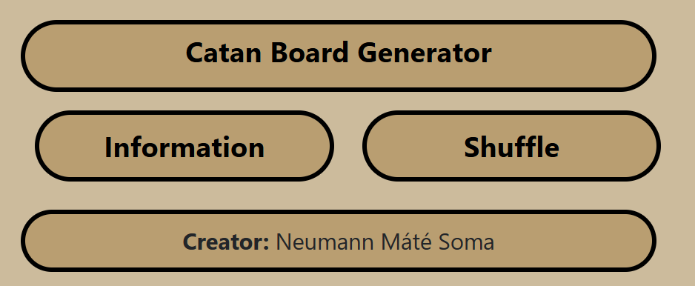
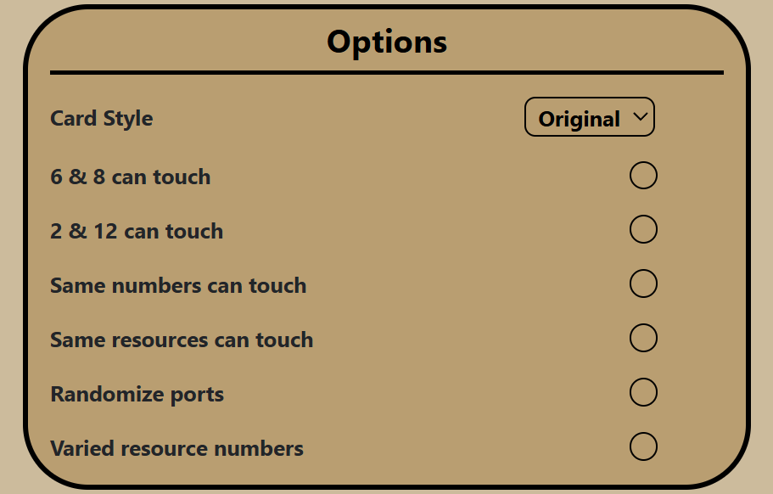
UI Description (2)
The left side
Header
Options Bar
When designing the header, I wanted to make something simple and informative, there is a title, a button for the information screen and a shuffle button.
For the options bar, I placed a theme selector on top, where the player can select from different card styles. There is a rule picker, where the player can turn on/off the different rules.

Slide 8
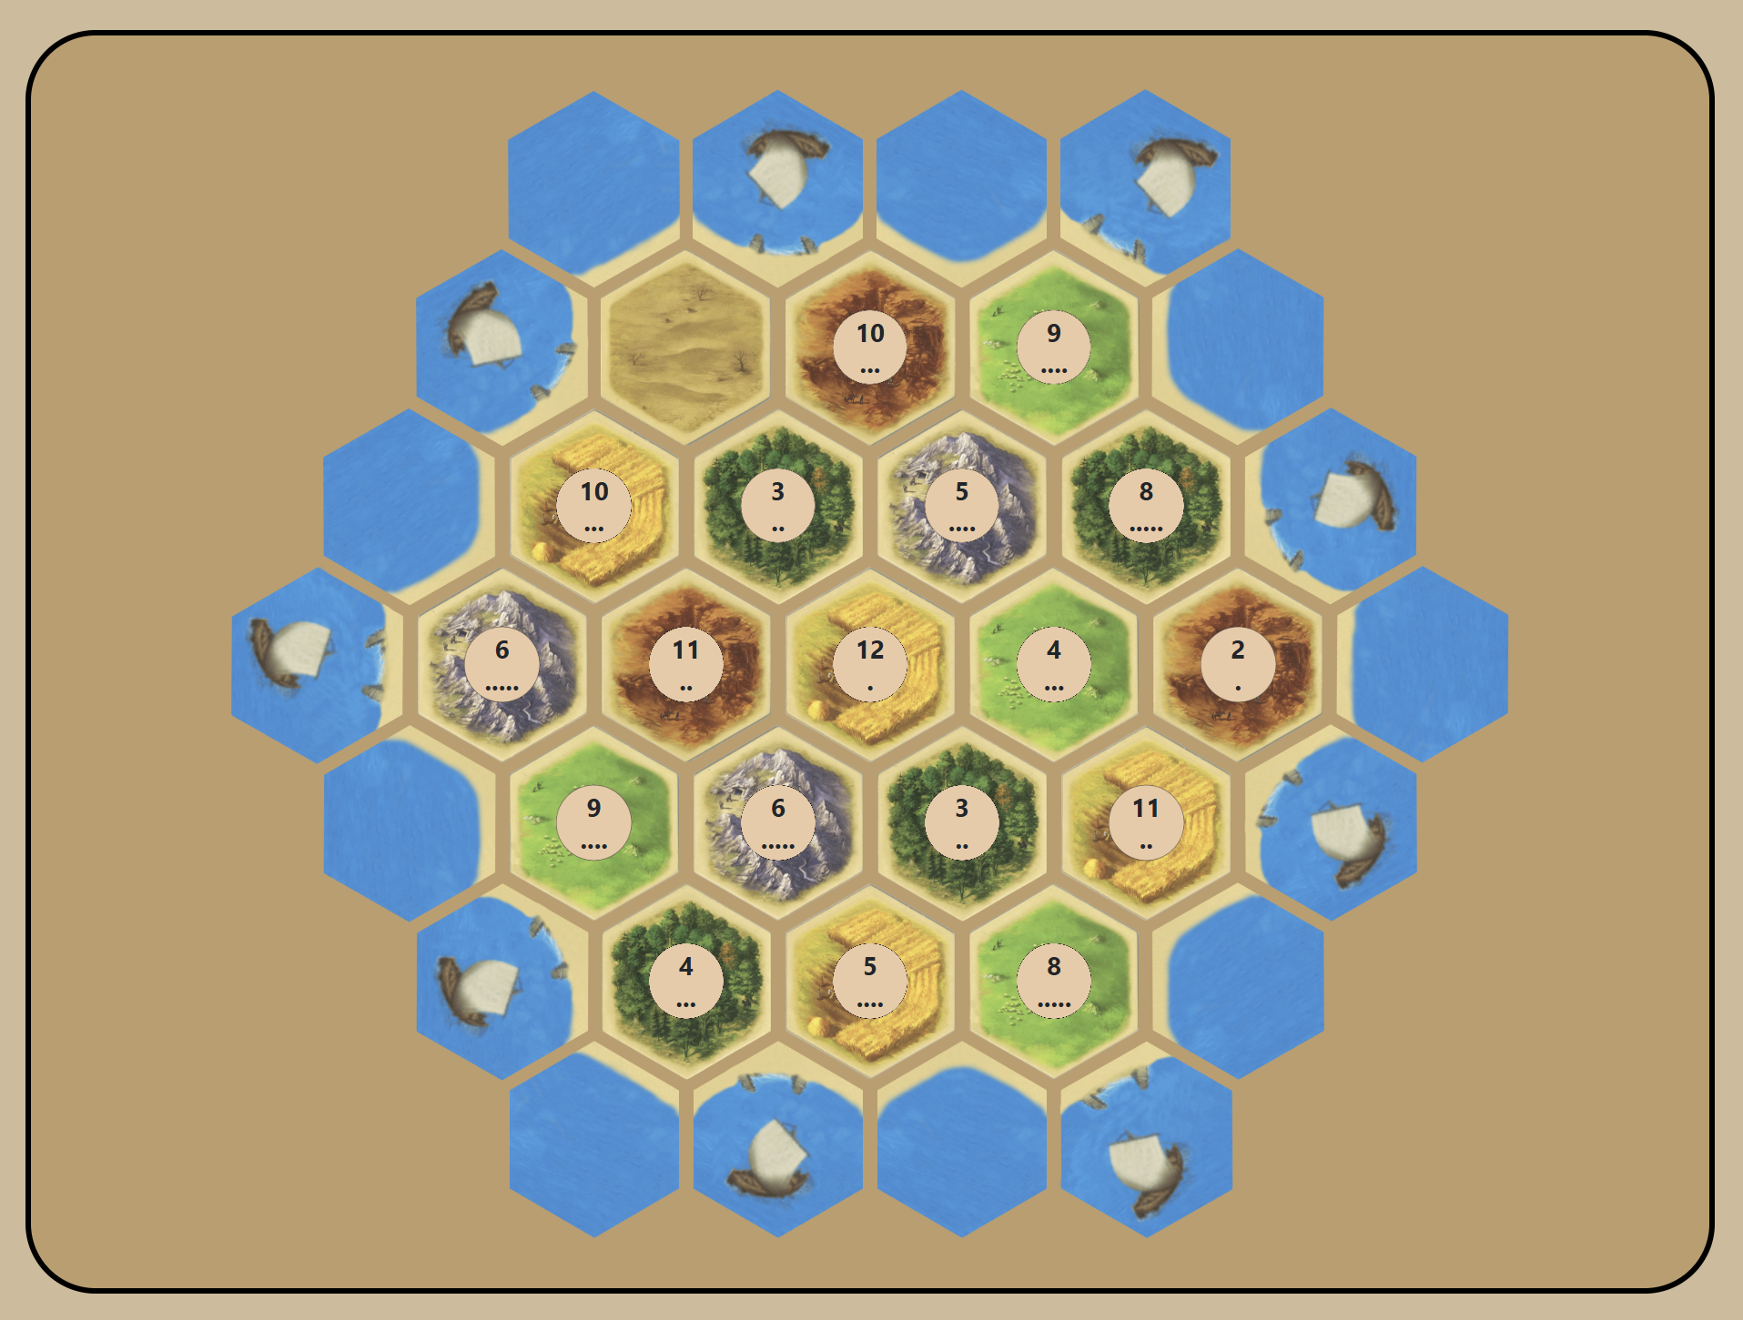
UI Description (3)
The right side
Map
This was the hardest part of the whole project. I had to make a grid from hexagons. It was especially hard placing the different rows on top of each other. I manipulated the margin of each tile to place it in the correct directions. A tile consists of a div with the card’s image as a background, then there’s a circle on top of that. It contains the possibility number distributed to that resource. Under the number, dots that indicate the possibility of that number.

Slide 9
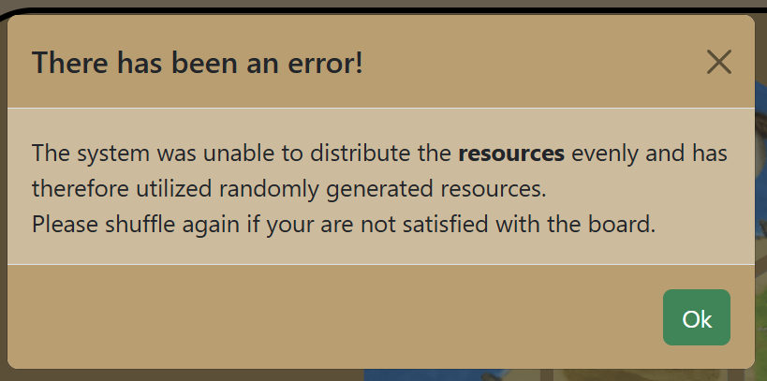
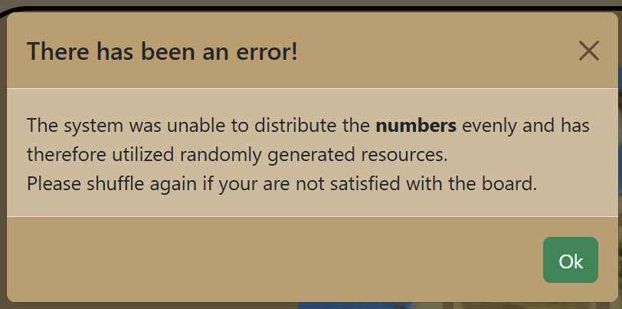
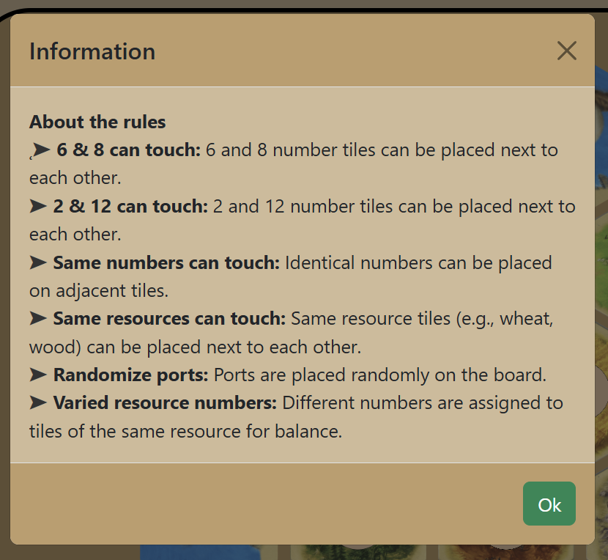
UI Description (4)
Modals
Concept
First, I was using the alert window, but I found that concept a bit boring, so I wrote modals for displaying information or errors.
Error modals
When generating the board, the algorithm can generate a bad board, where one or more of the rules cannot be fulfilled.
Information modal
First, I was using the alert window, but I found that concept a bit boring, so I wrote modals for displaying information or errors.

Slide 10
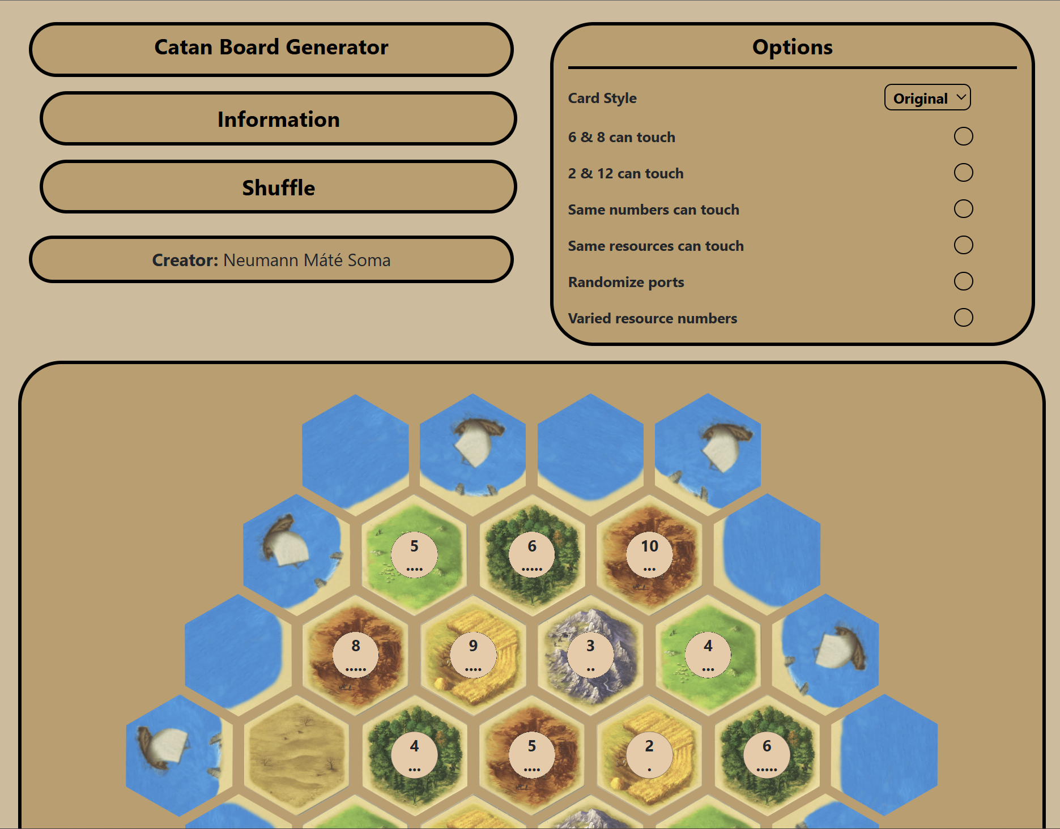
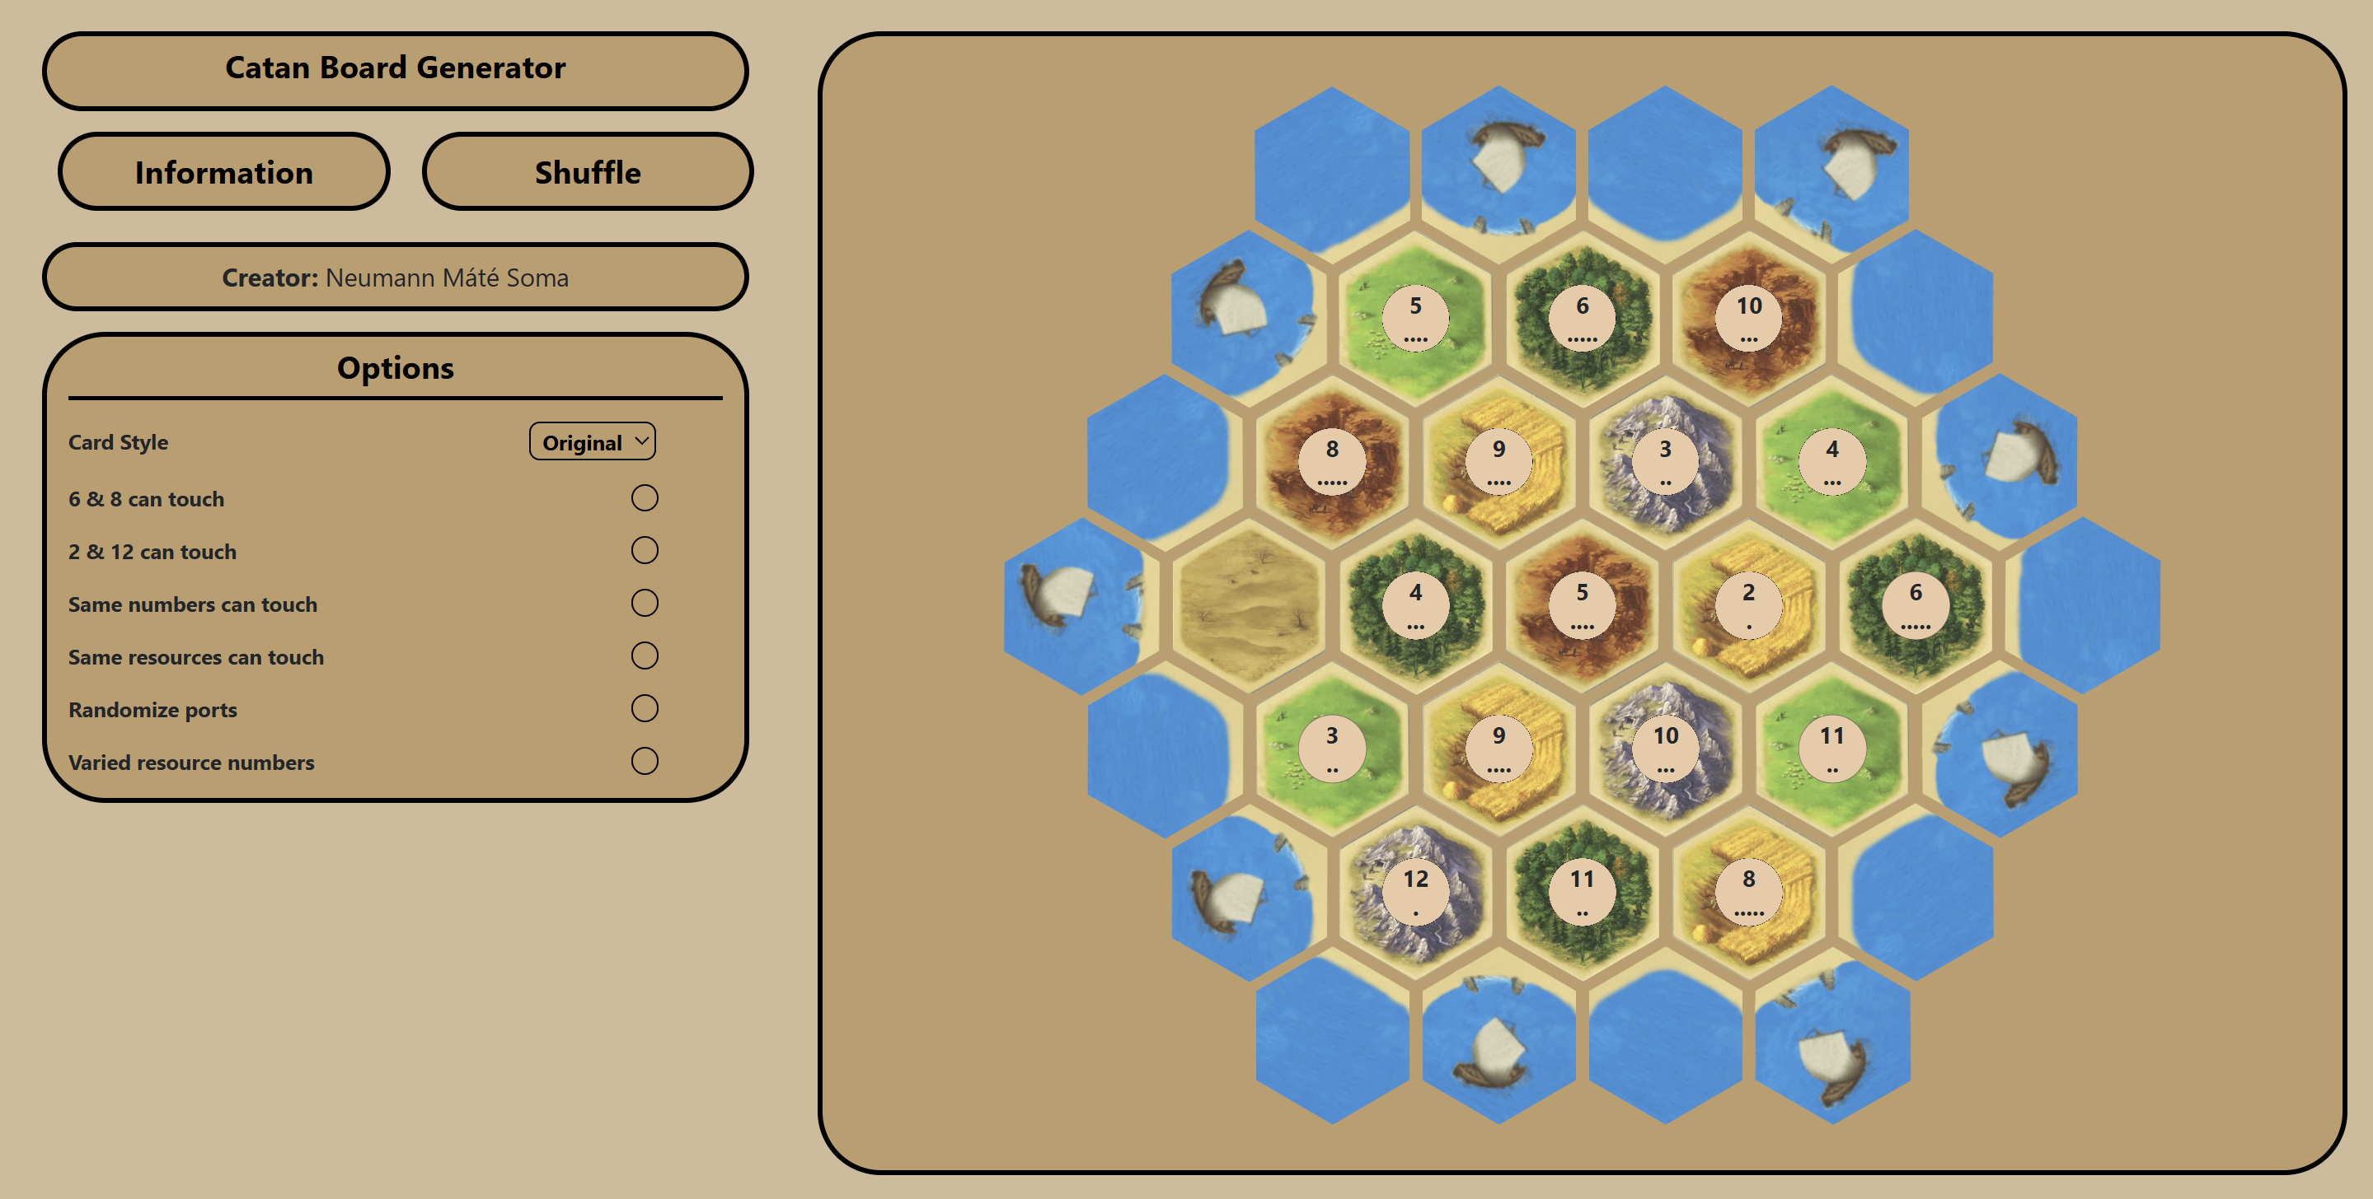
UI Description (4)
Responsiveness
Concept
Szerettem volna, hogy a weboldal több eszközméreten is elérhető legyen, a felhasználói élmény csökkenése nélkül. A weboldal kompatibilis a Bootstrap extra nagy, nagy, közepes és kis méretű eszközeivel.
Large
Extra Large

Slide 11
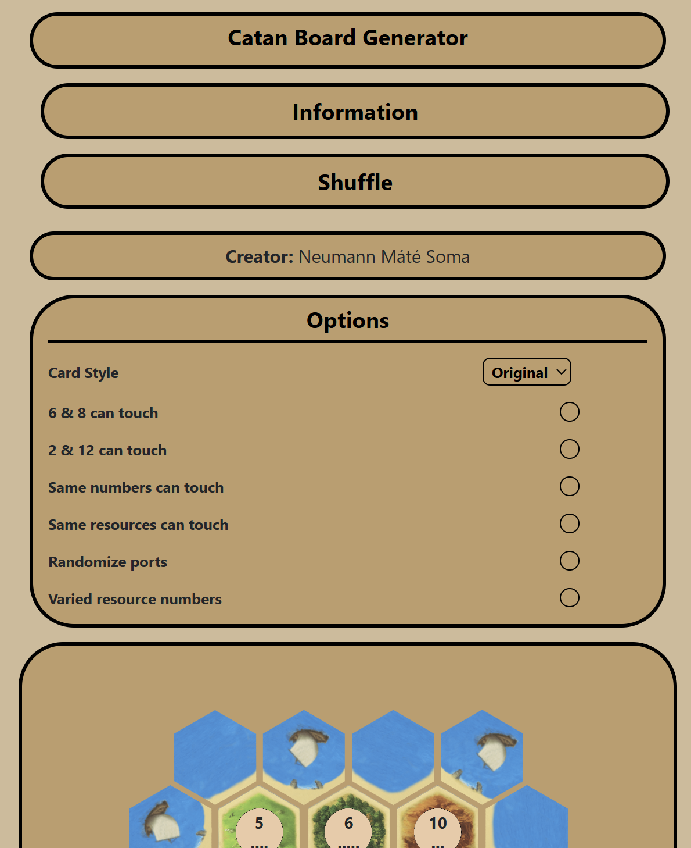
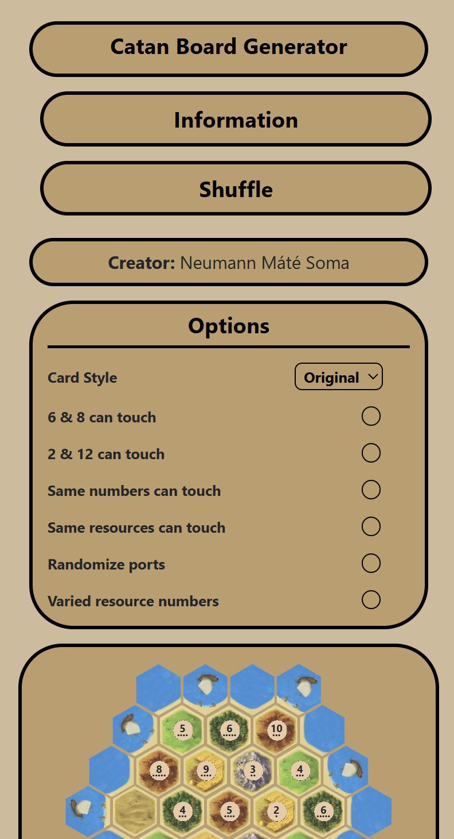
UI Description (5)
Responsiveness
Medium
Small

Slide 12
The Algorithm
Concept
First, I allocate the resources, which basically means, I randomly generate a board and then validate it, if the validation fails then a new board is generated. I repeat this process a maximum of 10,000 times and if it fails for the 10,000th time then I revert to a random generated board and notify the user with an error message. The number placement uses the same logic. After generating the board, I display it, which means I go through the whole board and place every tile into the right div. After that the algorithm checks if the ports needs to be randomised and places them based on that.

Slide 13
Further Opportunities
Expansion version
The expansion version of Catan is a version that allows more players (5-6) to play the game, with more cards on the map.
Seafarers version
The map contains other islands to conquer with ships. The board generation process would be the same, but there would be another island or more islands which players can conquer.
Saving the map
With this the map could be saved in a JSON or PNG format, which would allow the players to save boards which they liked.
Language integration
The website could be translated into multiple languages which would allow more players from around the world to play.

Slide 14
The End
Thank you for your attention!
Questions or feedback are welcome.

